Slide 1

Smart Education Platform
MERN Stack · Full Stack Web Application
6-Month Industrial Training Project
Presented by: Jay Kumar | GitHub: jayjaisswal
Live: padho-india.vercel.app

Slide 2

What Padho India Solves?
🎯
The Internet Made Content Cheap But Not Organized
Challenges
YouTube made video free. Telegram made PDFs free. But free and scattered is not the same as useful. A student still spends more time searching for the right content than actually studying it.
🌐
Teaching Online Requires Being a Developer First
If a teacher wants to sell a course online today, they either give 50% to Udemy or spend months building their own website or spend money to hire developers. There is no middle ground where a non-technical educator can simply sign up, create a course, and start earning.
👥
No Structured Practice PYQ for JEE or NEET Aspirants and Placement Students with Solution
JEE and NEET previous year questions are available on random websites but with no proper structure, no topic-wise organization, and no verified solutions. Aptitude MCQs for placement prep are equally scattered with no quality control. Students waste time finding questions, then waste more time.

Slide 3
🎯 Project Objectives
What Padho India is built to achieve
01
Unified Learning Hub
02
Free + Paid Access
Bring IIT JEE, NEET, Aptitude, Placement & general courses under one roof for every Indian student.
Offer free courses for underprivileged learners alongside premium paid content managed by instructors.
03
Empower Instructors
04
Secure & Trusted Platform
Give educators tools to create batches, upload videos, sell courses, and track earnings & students.
OTP-verified signup, JWT auth, role-based access — ensuring trust for both students and instructors.
05
Seamless Payments
06
Feedback Loop
Razorpay-powered enrollment so instructors monetize their content and students pay with confidence.
Students give feedback; instructors see reviews and ratings to continuously improve content.

Slide 4
Technology Stack
MERN Stack — Modern, scalable, JavaScript everywhere
⚛️ Frontend
🖥️ Backend
🗄️ Database
☁️ Services
• React 19
• Node.js
• MongoDB Atlas
• Cloudinary
UI library with hooks
JavaScript runtime
NoSQL cloud DB
Media storage & CDN
• Redux Toolkit
• Express.js
• Mongoose
• Razorpay
State management
Web framework
ODM for MongoDB
Payment gateway
• Tailwind CSS
• JWT
• Schema Design
• Vercel
Utility-first styling
Auth tokens
Nested schemas
Frontend hosting
• Vite
• Bcrypt
• Indexing
• Render
Fast build tool
Password hashing
Query optimization
Backend hosting
• Axios
• Nodemailer
• Relationships
• GitHub
HTTP client
Email notifications
Refs & population
Version control

Slide 5
📋 What's Available on Padho India?
All categories of learning content — from competitive exams to career prep
🧮
Aptitude Training
🏛️
IIT JEE PYQs
🔬
NEET PYQs
Quantitative, Logical Reasoning, Verbal Ability — full prep for campus placements and govt exams.
Year-wise previous year question papers with structured solutions by expert instructors.
Biology, Physics, Chemistry PYQ sets with detailed explanations for medical entrance aspirants.
💼
Placement & Interview
📄
PDF Notes
🆓
Free Courses
DSA, System Design, HR rounds, coding challenges — complete placement preparation module.
Downloadable chapter-wise notes for quick revision, available for both free and paid courses.
Created free courses ensure quality learning is available to every student regardless of budget.

Slide 6
👨‍🏫 Instructor Dashboard — Full Control
Everything an educator needs to teach, sell, and grow
📦
Create Batches
📹
Upload Video Lectures
Organize courses into batches with sections and sub-sections. Structure content just like a classroom syllabus.
Upload videos to Cloudinary CDN — auto-delivered to students worldwide with adaptive streaming.
💰
Sell Courses
📊
Total Earnings View
Set your own price for each course. Free or paid — you decide. Razorpay handles all payments securely.
Real-time dashboard showing total revenue, per-course earnings breakdown, and payment history.
👥
Total Students
⭐
Reviews & Ratings
See exactly how many students enrolled in each course and overall — understand your reach and impact.
Read every student review and overall rating per course — use feedback to improve and grow your audience.

Slide 7
👨‍🎓 Student Experience
From signup to course completion — a seamless learning journey
1
Sign Up & Verify
2
Browse Courses
3
Enroll Instantly
Register → receive OTP on email → verify → account ready in under 60 seconds.
Explore IIT JEE, NEET, Aptitude, Placement, PDF Notes. Filter free or paid.
Free courses: one-click enroll. Paid courses: secure Razorpay checkout with confirmation email.
4
Watch & Learn
5
Practice
6
Rate & Review
Stream video lectures via Cloudinary CDN. Download PDF notes for offline revision.
Practice Q A and Prepare accordingly like Aptitude IIT NEET etc.
Leave a star rating + written review. Help fellow students and give instructors feedback.

Slide 8
💳 Razorpay Payment Integration
Industry-standard payment gateway ensuring secure, seamless course enrollment
STEP 1
STEP 2
STEP 3
Student Selects Course
Order Created (Backend)
Razorpay Checkout Opens
Student browses catalog, clicks 'Enroll Now' on a paid course page.
Express server calls Razorpay API → returns order_id to frontend.
Native Razorpay popup — student pays via UPI, Card, Netbanking, or Wallet.
STEP 4
STEP 5
STEP 6
Signature Verification
Enrollment Confirmed
Email Receipt Sent
Backend verifies HMAC-SHA256 payment signature to prevent fraud.
Student added to course's enrolledStudents[ ] in MongoDB Atlas.
Nodemailer sends payment confirmation + course welcome email instantly.

Slide 9
💡 Challenges & Learnings
🔄
JWT Refresh Flow
💳
Razorpay Signature
Implementing secure token refresh without re-login — solved with httpOnly cookies and refresh token rotation.
Payment signature verification using HMAC-SHA256 to prevent fraud — required deep dive into crypto module.
📹
Data Collection
🏗️
Nested Schemas
Collect Data and cleaning it using Jupyter Lab and Python
Designing Course → Section → SubSection schema relationships in MongoDB with proper population queries.
🔐
Role-Based Auth
📧
Email Templates
Implementing middleware that checks both JWT validity and user role (Student vs Instructor) for every endpoint.
Building responsive HTML email templates for OTP, enrollment confirmation, and password reset flows.

Slide 10
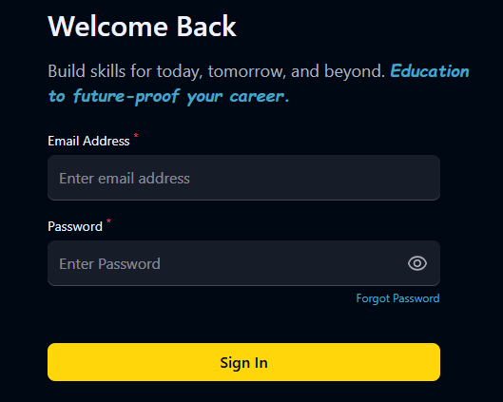
🔐 Login Page
Secure JWT-based authentication for students and instructors
Auth Flow
[ Insert Login Page Screenshot Here ]
Key Features
Email & password login with JWT token generation
OTP-based verification for account security
Role-based redirect: Student vs Instructor dashboard
Forgot password flow with email reset link

Slide 11
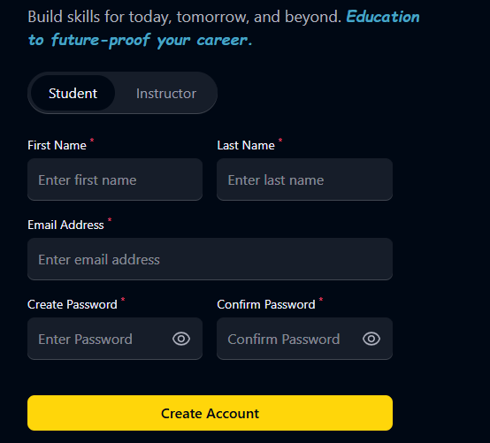
📝 Signup Page
Onboard in under 60 seconds with OTP email verification
Registration
[ Insert Signup Page Screenshot Here ]
Key Features
Name, email, password & role selection (Student / Instructor)
OTP sent to email — verified before account activation
bcrypt password hashing on the backend
Instant redirect to dashboard after successful signup

Slide 12
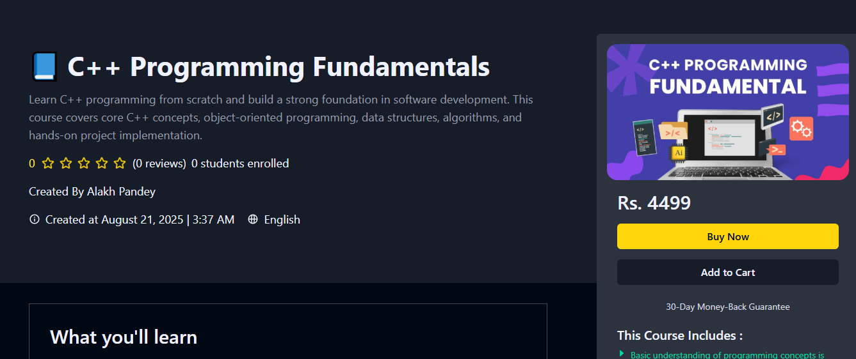
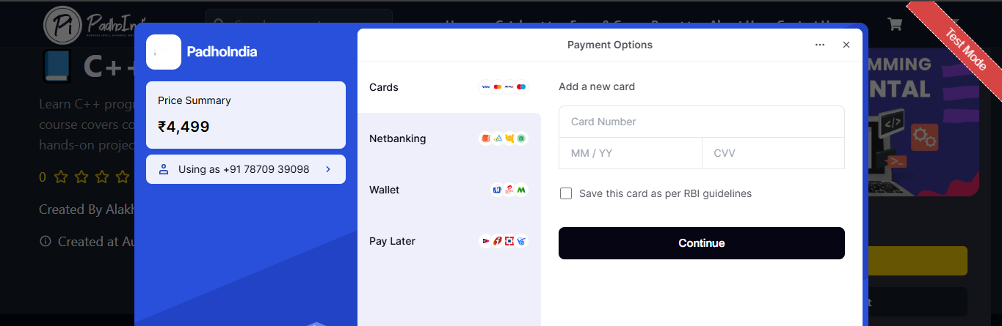
💰 Paid Courses
Premium content managed by instructors with Razorpay checkout
Paid Access
[ Insert Paid Courses Screenshot Here ]
Key Features
Course cards with price, instructor name & ratings
Razorpay payment gateway integration
Enrollment confirmed via email after payment
Access locked until payment verified by backend

Slide 13
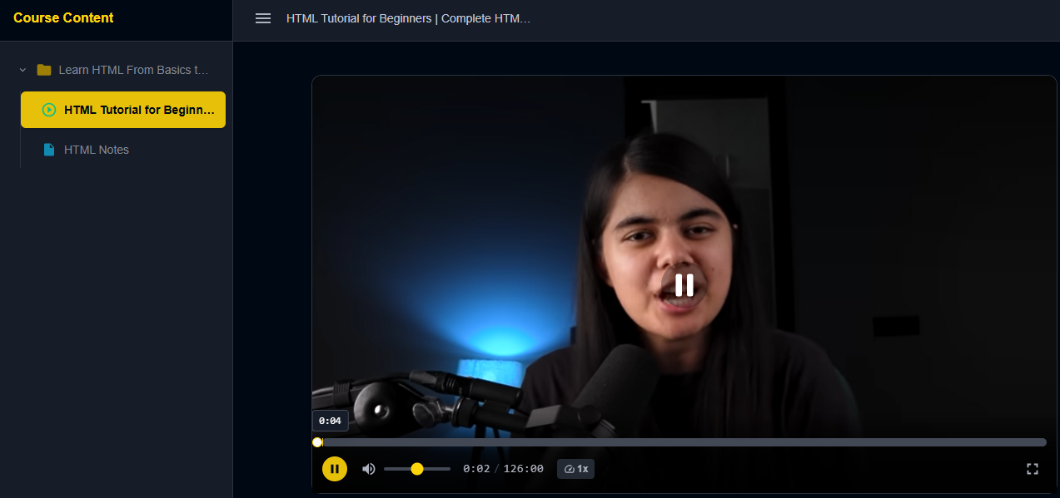
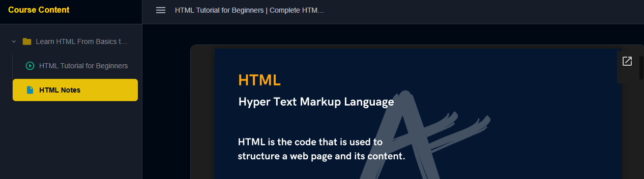
🆓 Free Courses
Zero-barrier learning for every student regardless of budget
Free Access
[ Insert Free Courses Screenshot Here ]
Key Features
no payment required
Full video lecture access via Youtube Private and public Structure Playlist
Available to all registered users instantly
Covers Development,, Aptitude & general subjects

Slide 14
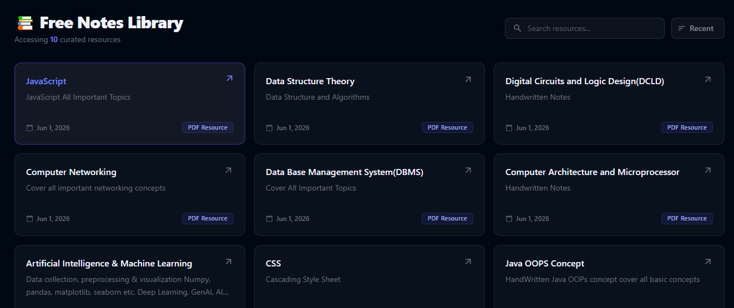
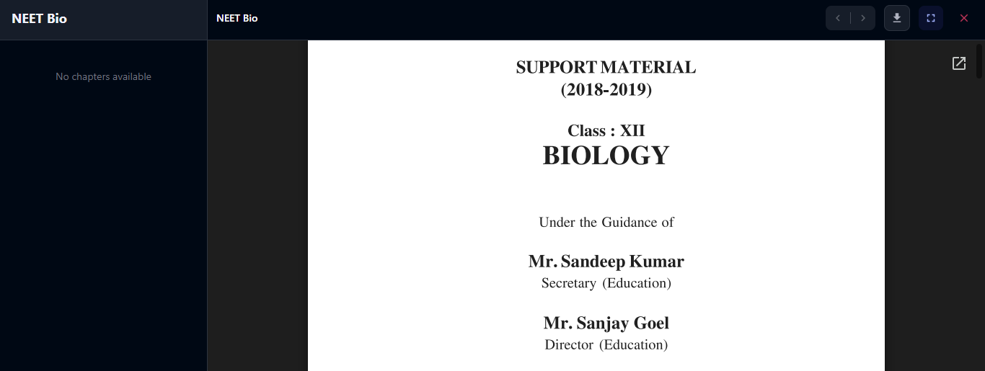
📄 PDF Notes
Topic-wise downloadable notes for offline revision
Study Material
[ Insert PDF Notes Screenshot Here ]
Key Features
Chapter-wise PDF notes for JEE, NEET & Placement
Download available for both free and paid users
Cloudinary storage with fast CDN delivery
Organized by subject, topic & difficulty level

Slide 15
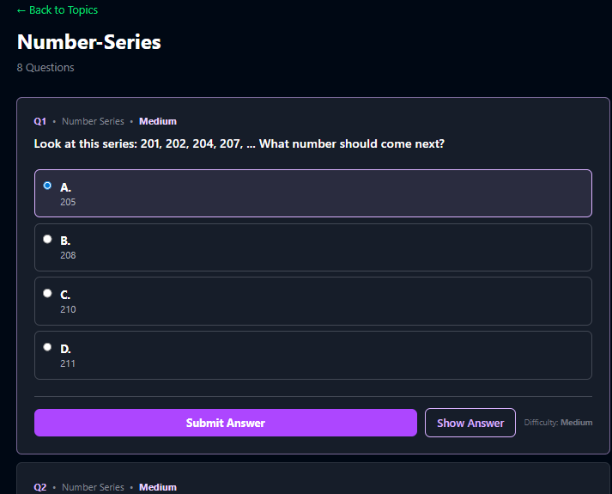
🧮 Aptitude Section
Placement-ready MCQs with solutions for campus recruitment
Aptitude Prep
[ Insert Aptitude Section Screenshot Here ]
Key Features
Quantitative, Logical Reasoning & Verbal Ability MCQs
Topic-wise question sets with detailed solutions
Difficulty filters: Easy / Medium / Hard
Targeted for TCS, Infosys, Wipro & top MNC patterns

Slide 16
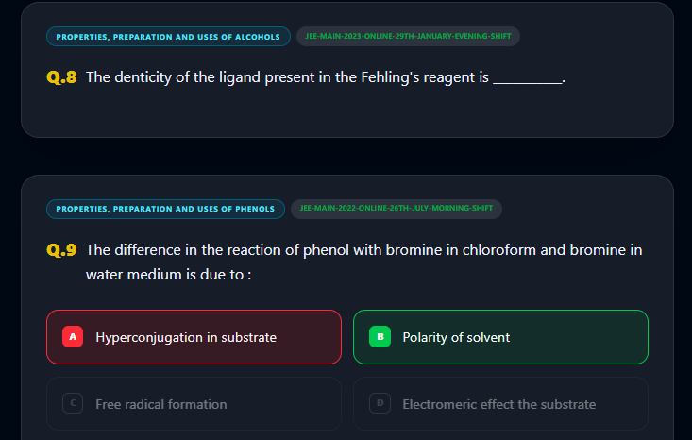
⚗️ Chemistry PYQ
Previous year questions with structured NEET solutions
NEET PYQ
[ Insert Chemistry PYQ Screenshot Here ]
Key Features
NEET Chemistry PYQs organized by year & chapter
Inorganic, Organic & Physical chemistry sections
Verified solutions with concept explanation
Filter by topic: Mole concept, Equilibrium, Bonding, etc.

Slide 17
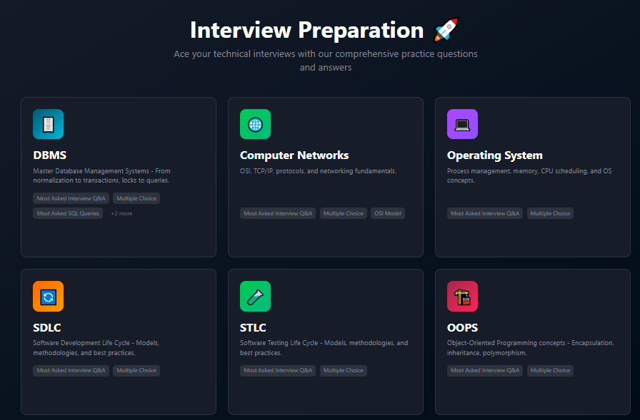
🎯 Interview Preparation
OS, HR rounds & DBMS for on campus & off-campus drives
Interview Prep
Key Features
Best for IT Engineers all at one Place
HR interview Q&A: strengths, weaknesses, situational
DBMS, OS, Computer Networking etc
Practice MCQs

Slide 18
🙏 Thank You!
Padho India — Smart Education Platform
🛠️
☁️
🔐
💳
MERN Stack
Cloud Ready
Secure
Payments
MongoDB · Express React · Node.js
Vercel · Render MongoDB Atlas
JWT · OTP Bcrypt · HTTPS
Razorpay Integrated
🔗 Live Demo: padho-india.vercel.app
📁 GitHub: github.com/jayjaisswal/MERN-Smart-Education-Platform
Built with ❤️ by Jay Kumar | 6-Month Industrial Training Project

